Slide 1
VoiceFilter: Targeted Voice Separation by Speaker-Conditioned Spectrogram Masking
Authors: Quan Wang, Hannah Muckenhirn, Kevin Wilson, Prashant Sridhar,
Zelin Wu, John Hershey, Rif A. Saurous, Ron J. Weiss, Ye Jia, Ignacio Lopez Moreno
Presented by: Quan Wang <quanw@google.com>
Notes:
Paper: https://arxiv.org/abs/1710.10467
Hello everyone.
My name is Quan Wang. I'm from the Google Speech team.
Today I will introduce a system we developed, named VoiceFilter.
This system separates the voice of a target speaker, by conditioning a spectrogram masking algorithm on the speaker embedding.

Slide 2
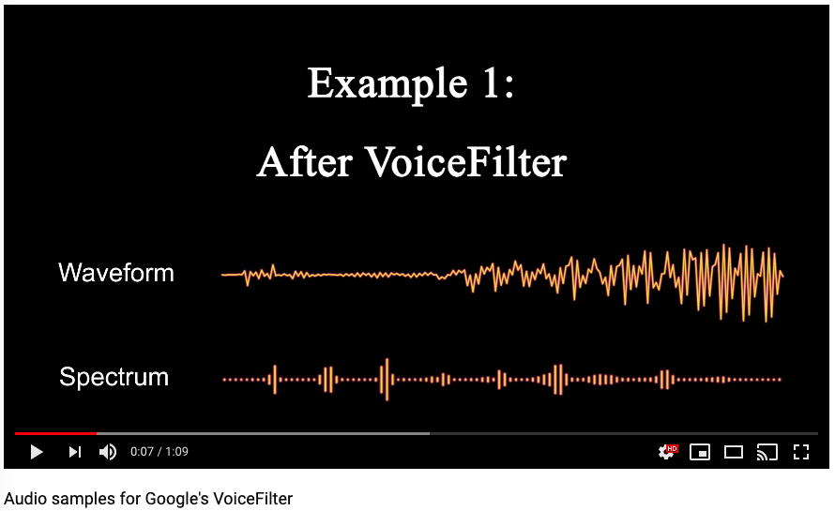
Teaser
Notes:
Before we go to any technical details, let's see a demo video.

Slide 3
Part 1:
Introduction
Notes:
OK. The demo is cool. Let's see how it works.

Slide 4
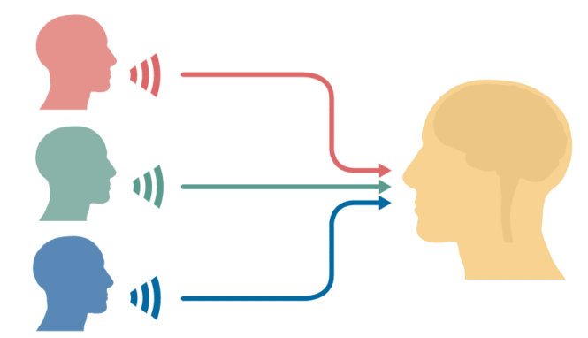
The Cocktail Party Problem
The problem:
Multiple talkers speaking simultaneous
You just want to listen to one person
Solutions:
Multi-channel blind separation
Single-channel blind separation
Image from elixirofknowledge.com
Image from Nima Mesgarani, Columbia University
Notes:
The problem we are solving is known as the cocktail party problem.
When multiple talkers are speaking, and you only want to listen to one person, that's easy for human but difficult for machines.
If there are multiple channels, like human has two ears, multi-channel blind separation algorithms can be used.
But many devices like mobile phones only have one microphone, then single-channel blind separation algorithms can be used.

Slide 5
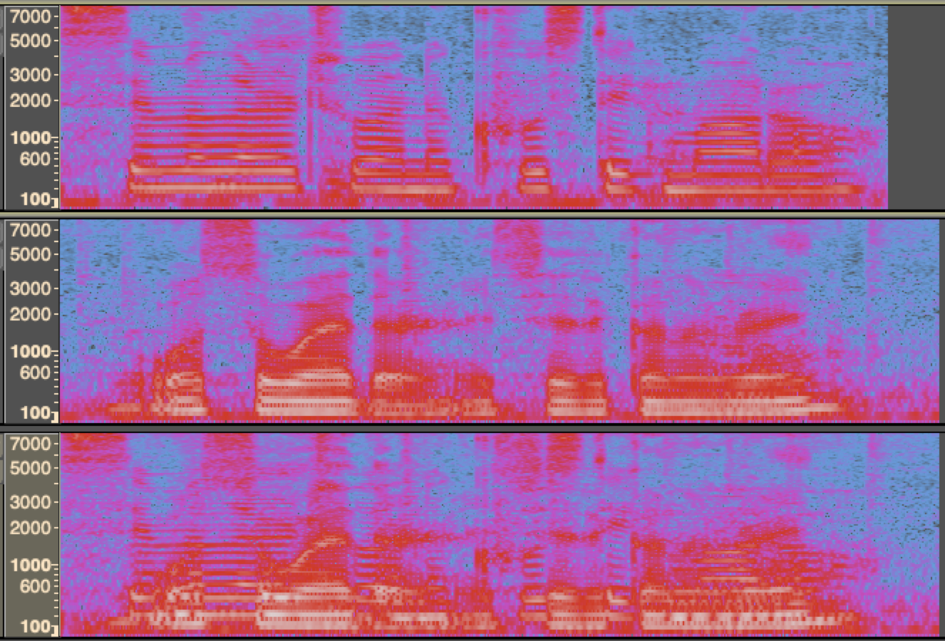

Mixing is Easy, Separation is Hard
Female voice source
Male voice source
Mixed observation
Mel-scale spectrograms, visualized in Audacity
Notes:
Let's look at an example.
Here are 3 spectrograms. The first is a female voice, the second is a male voice, and the last is a mixed one. Let's listen to them.

Slide 6
Spectrogram Masking
Source recovery
Notes:
If we want to recover the male voice from the mixed one, intuitively, we could use an eraser on the spectrogram to remove the harmonics of the female voice.
In practice this is doable, and we call that "spectrogram masking".

Slide 7
Single-Channel Blind Source Separation
Lots of great existing work!
Deep clustering, 2016
Deep attractor network, 2017
Permutation invariant training, 2017
But not really what we need…
We usually know “whom to listen to”
Notes:
There are already lots of great work on single channel blind separation. For example, the deep clustering, deep attractor network, and permutation invariant training.
But, these are not really what we need, because in our cases, we usually know "whom to listen to".

Slide 8
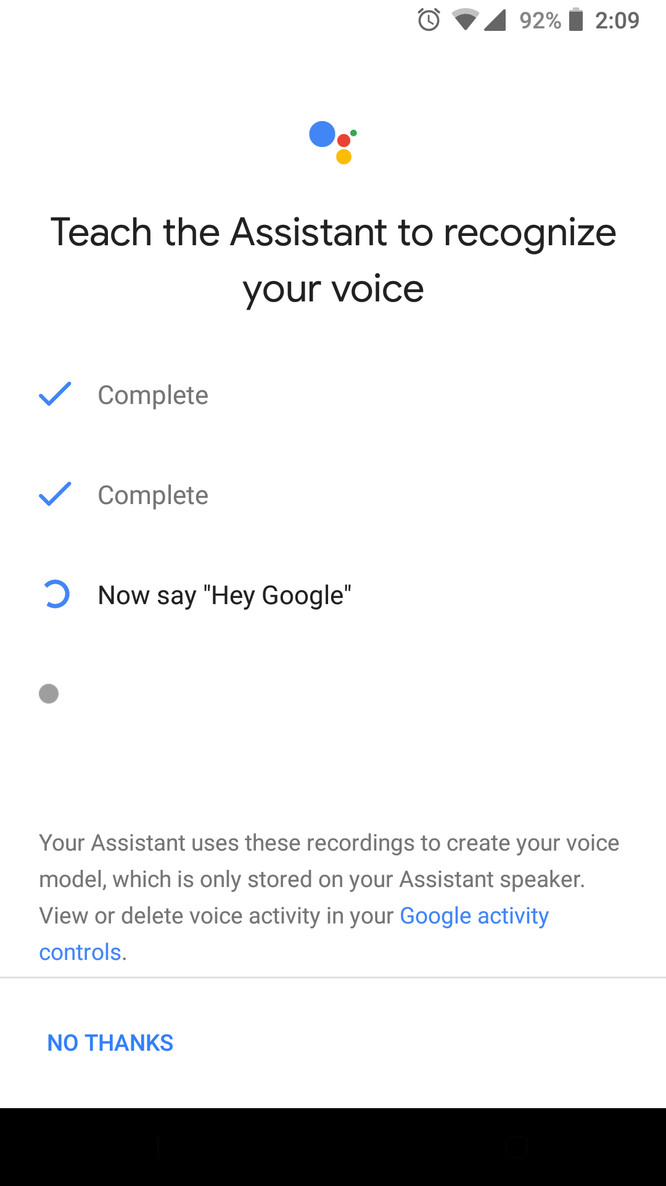
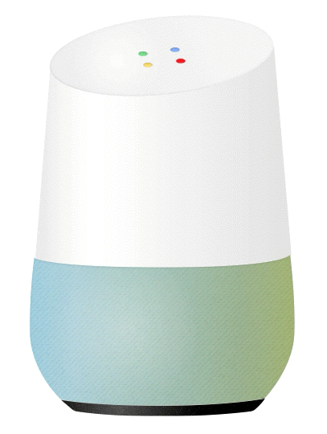


Knowing “whom to listen to”
Voice Match already deployed to:
Android smart phones
Smart speakers
User’s voice profile stored on device
Blindness sucks
Number of sources is unknown
Single: don’t want to mess up
Multiple: only keep target voice
Multiple outputs, still don’t know which one to use (e.g. to run ASR)
Pick loudest?
Run speaker verification on all?
Permutation invariance: computational cost is high!
Notes:
For example, if you have an Android Phone or Google Home device, you can enable VoiceMatch, which will store a voice profile on the device.
With this voice profile, we are no longer blind.
Here I will explain why blindness sucks.
First, in blind separation, you don't know how many sources are there in the runtime. You may be doing great when the input has multiple sources, but you also don't want to mess up when the input is already single source.
Second, blind separation usually has multiple outputs, you still need to pick the one you need, for example to run ASR.
You can simply pick the loudest one from the outputs, or use an additional speaker verification step, but it's not a trivial task itself.
Finally, permutation invariant training is usually very expensive.

Slide 9
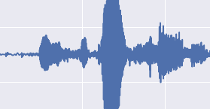
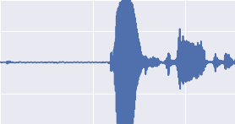
VoiceFilter: Say Goodbye to blindness!
Condition the voice separation task by target speaker embedding
Target speaker embedding
VoiceFilter
Blind separation
Noisy multi-speaker audio
Clean audio of target speaker
Notes:
So, with the proposed VoiceFilter system, we can say Goodbye to blindness.
We make use of the speaker embedding, which can be acquired during user enrollment. This speaker embedding will condition the separation system to output the clean signals from the target speaker.

Slide 10
Part 2:
VoiceFilter Models
Notes:
Next I will talk about our models.

Slide 11
Two Separately-Trained Networks
Speaker encoder
Input: an utterance
Output: speaker-discriminative embedding
VoiceFilter
Input 1: magnitude spectrogram
Input 2: speaker-discriminative embedding
Output: mask
Notes:
We basically have two models, and they are separately trained with different datasets.
The speaker encoder model takes an utterance as input, and outputs a speaker-discriminative embedding.
The VoiceFilter model takes both a noisy spectrogram and the embedding as input, and outputs a mask.

Slide 12
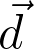
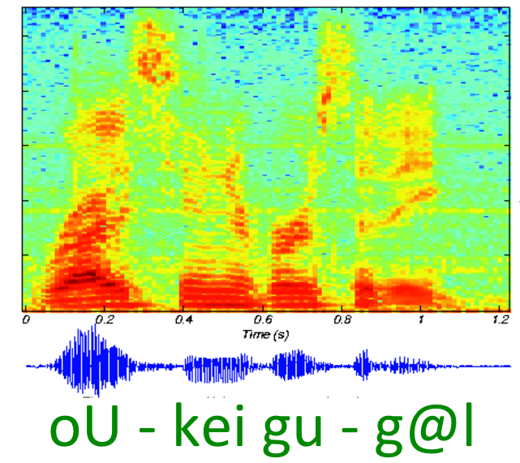
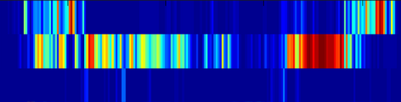
Speaker Encoder: The d-vector system
LSTM
Cell
LSTM
Cell
LSTM
Cell
LSTM
Cell
LSTM
Cell
LSTM
Cell
LSTM
Cell
LSTM
Cell
LSTM
Cell
Fixed-length segment
Multi-layer LSTM network
D-vector
Wan, Li, Quan Wang, Alan Papir, and Ignacio Lopez Moreno. “Generalized end-to-end loss for speaker verification.” In 2018 IEEE International Conference on Acoustics, Speech and Signal Processing (ICASSP), pp. 4879-4883. IEEE, 2018.
Notes:
The speaker encoder is also known as the d-vector system. It's basically a multi-layer LSTM network. You can find more details in this paper.

Slide 13
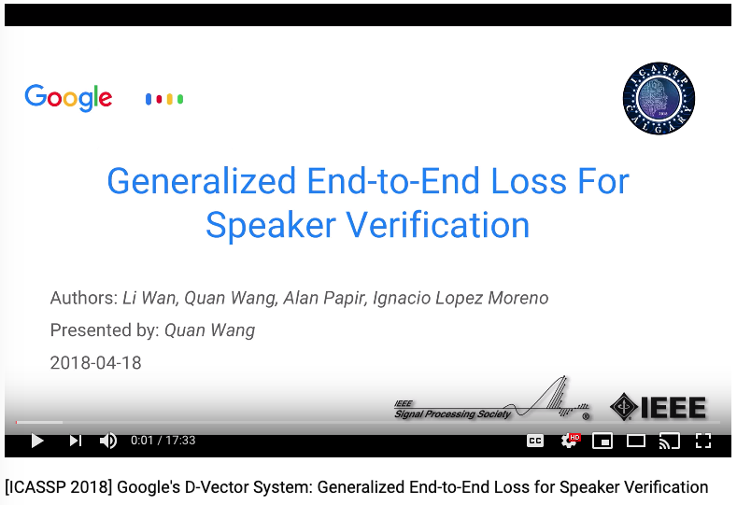
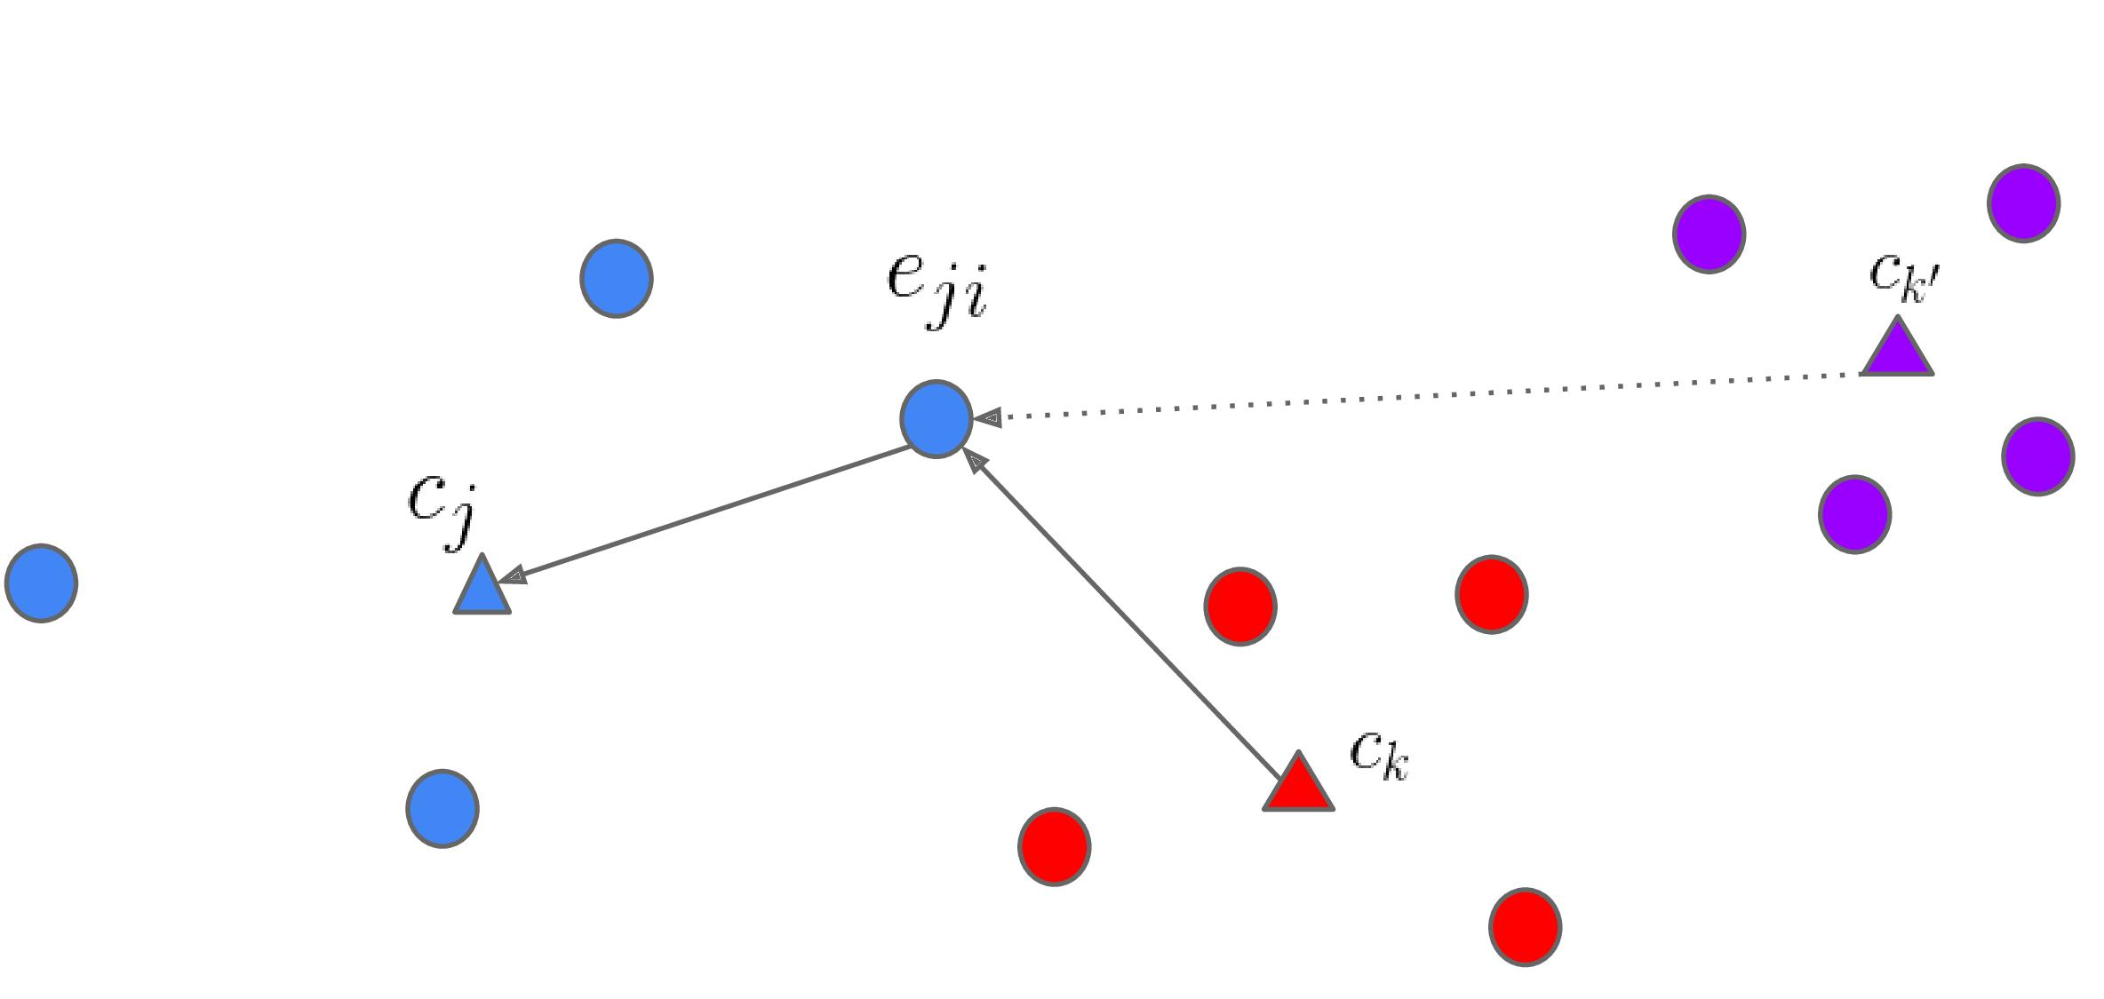
Speaker Encoder: The d-vector system
Lecture available on
Scalable
Trained on 100K+ speakers
Efficient
Max-margin principle in each step
GE2E has proven better performance than:
Softmax cross-entropy loss
Triplet loss
Tuple end-to-end loss
Notes:
I also uploaded my lecture on this system to YouTube, so you could watch this video if you are interested.
Basically, our d-vector system is a highly scalable system, trained on hundreds of thousands of speakers. It's very efficient, and has proven better performance than other systems like cross-entropy, triplet loss, or tuple end to end loss.

Slide 14
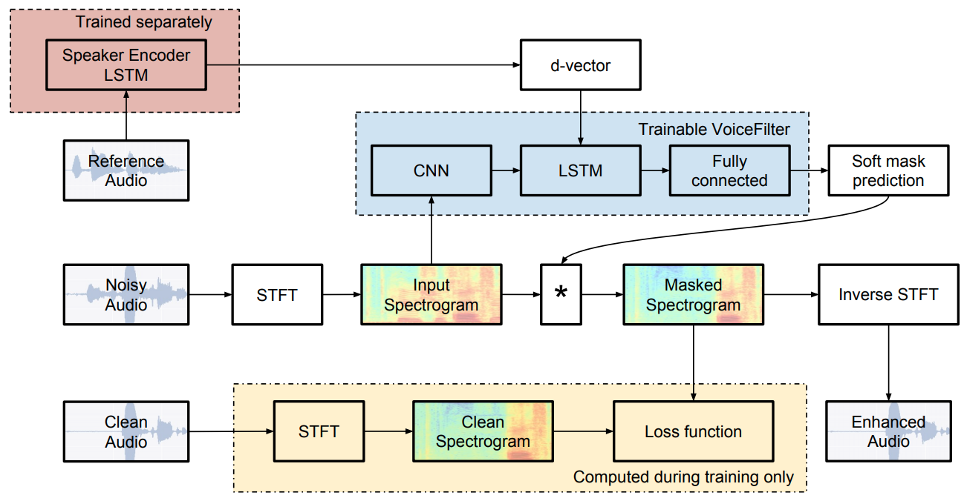
VoiceFilter: System Architecture
Notes:
The second network, the VoiceFilter network, is the real focus of this work. And here is the system architecture.
There are 3 inputs during training.
The reference audio is the one that we compute the d-vector. And we repeat the d-vector every frame as the input to the LSTM.
The noisy audio is the one to be enhanced.
And the clean audio is the ground truth to compute the loss function.
The VoiceFilter network outputs a mask. Then we multiply the mask with the noisy spectrogram to get the enhanced spectrogram.

Slide 15
Design Details Explained
Why concatenate between CNN and LSTM?
CNN: captures time-frequency contextual information
d-vector is already compact, no need for convolutions
LSTM: emphasizes speaker information through time
Why masking not regression?
Actually both will work
Masking has proven better performance
Masking is more intuitive for additive noise
Notes:
Here I will explain some of the design details.
First, we concatenate the d-vector with the noisy spectrogram between convolutional layers and LSTM. This is because, convolutional layers are used to capture context information. But d-vector is already very compact, so there's no need to put it before convolutional layers.
Second, we are doing masking. But that's not the only way to do it. Many people use a regression network to directly output the enhanced spectrogram. We find masking is faster and has better performance, so we are using masking instead of regression in our work.

Slide 16
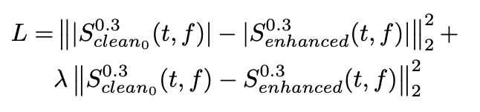
Design Details Explained
How to compute loss?
We compute error for both:
Magnitude spectra
Complex spectra
Power-law compression by 0.3
How to reconstruct audio?
Spectrogram has two components:
Magnitude: apply the mask
Phase: just use that from noisy source
Phase
Notes:
About the loss function. We are computing L2 reconstruction loss for both the magnitude and the complex spectra. This is following the practice of existing previous work.
We also know that human hearing is non-linear. So we use a power-law compression of 0.3 to equalize the importance of quiet sounds relative to loud ones.
When we reconstruct the enhanced audio, we need the full complex spectrogram. For the magnitude, we can use the one we get by masking the input. For the phase component, we directly use the phase of the noisy input without any processing.

Slide 17
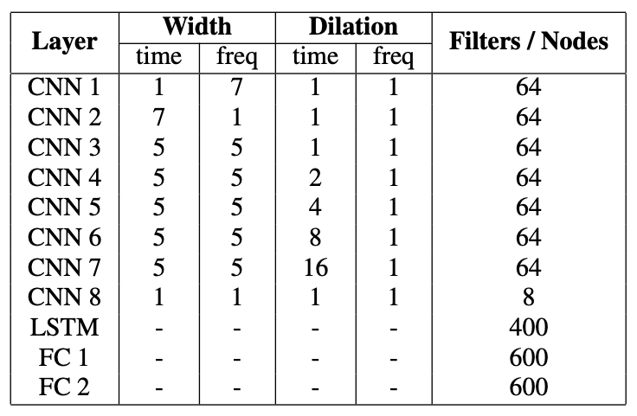
Network Topology
Speaker encoder
3 LSTM layers of 768 nodes and 256-dim projections
VoiceFilter
8 convolutional layers
With dilations in time domain
1 LSTM layer
2 fully connected layers
Notes:
Here are the topologies of the networks.
Speaker encoder is simply 3 layers of LSTM.
VoiceFilter has many more layers, including 2-dimensional convolutional layers, LSTM layer, as well as fully connected layers.

Slide 18
Part 3:
Data
Notes:
Next, I will talk about the data.

Slide 19
Data for Speaker Encoder
Data requirement to train a good speaker encoder
A large number of speakers (prefer 10K+)
Multiple utterances per speaker (to form pos/neg pairs)
Prefer noisy data, no need for transcription
Our training data
Anonymized voice query logs in English
From both mobile phones and farfield devices
34M utterances from 138K speakers
Public datasets
LibriSpeech, VoxCeleb, VoxCeleb2
Notes:
The data requirements for speaker encoder and VoiceFilter are very different, so we train them separately.
For the speaker encoder, we need a very large number of speakers for training, such that we can generalize well to unseen speakers. Our datasets consist of 34 million utterances from more than one hundred thousand speakers. But we don't need any transcription of the data.

Slide 20
Data for VoiceFilter
Data requirement to train/eval VoiceFilter model
Reasonably big number of speakers (prefer 1K+)
Multiple utterances per speaker (to compute embeddings)
Prefer clean data (to not confuse the system)
Transcription needed for ASR evaluation
Our data
Public transcribed dataset: VCTK and LibriSpeech
Divide each dataset to training and eval subsets
No common speaker between training and eval
Notes:
The data requirement for the VoiceFilter network is a bit different. For example, if we want to evaluate speech recognition performance, then we will need the transcriptions.
There are some good public datasets like the CHIME challenge dataset. But remember, VoiceFilter needs a reference audio for enrollment, so we cannot directly use CHIME. Instead, we use VCTK and LibriSpeech in this work.

Slide 21
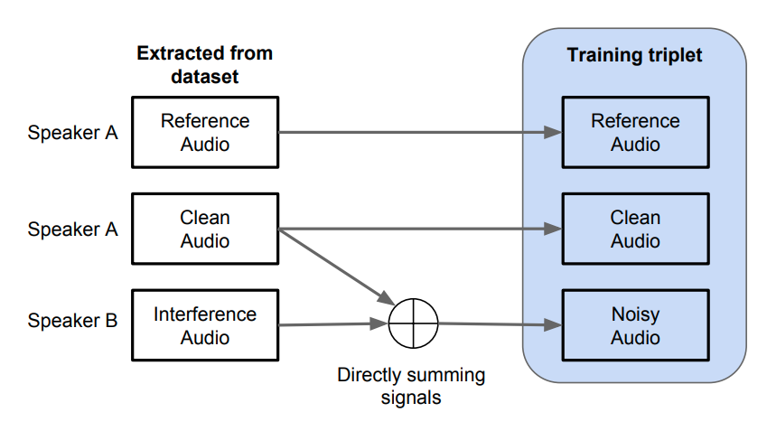
Data Processing for VoiceFilter
Data processing workflow
Training workflow
Notes:
We mentioned that our training workflow needs three audios: the clean, noisy, and reference audio. We can get them all from a clean dataset.
So here is the data processing workflow.
From the clean dataset, we extract 3 audios. The reference and clean audios are from the same speaker. The interference audio is from a different speaker. We sum the signals from the clean and interference audios to generate the noisy audio for training.

Slide 22
Part 4:
Experiments
Notes:
Next, I will show some of our experimental results.

Slide 23
Evaluation Metrics
Our ultimate goal is to improve ASR, so we report Word Error Rate (WER)
Success criterion:
Multi-speaker (noisy) scenarios: VoiceFilter lowers WER – being useful
Single-speaker (clean) scenarios: same WER – being harmless
We also report Source to Distortion Ratio (SDR)
Commonly used metric for source separation
Larger is better
Notes:
We are going to use two metrics: Word Error Rate and Source to Distortion Ratio.
We report Word Error Rate because our ultimate goal is to improve speech recognition. Our success criterion has two parts. First, if the audio is noisy, from multiple speakers, VoiceFilter should reduce Word Error Rate, meaning we are really being helpful.
Second, if the audio is already clean, from a single speaker, then VoiceFilter should have the same Word Error Rate, meaning we are being harmless.
Source to Distortion Ratio is about the quality of the enhanced audio. It's a popular metric in source separation, so we also use that.

Slide 24
Word Error Rates
We look at four WER numbers:
Clean WER
Noisy WER
Clean-enhanced WER
Noisy-enhanced WER
We use a conventional ASR model trained on YouTube data
Clean audio
ASR
Should not degrade
Noisy audio
ASR
Clean audio
VoiceFilter
ASR
Should improve
Noisy audio
VoiceFilter
ASR
Notes:
For the Word Error Rate, we are going to look at four numbers for each experiment.
The clean WER with and without VoiceFilter. And the noisy WER with and without VoiceFilter. We hope that after we used VoiceFilter, clean WER is the same, and noisy WER is lower.

Slide 25
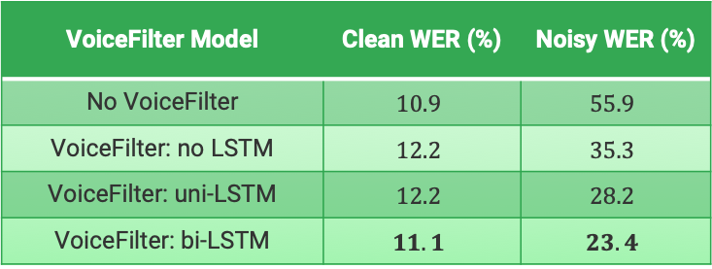
WER results: topology matters
Compare different topologies
All trained on LibriSpeech
WER evaluated on LibriSpeech
Bidirection LSTM is best
Bi-LSTM also has more parameters
VoiceFilter Model | Clean WER (%) | Noisy WER (%)
No VoiceFilter | $$10.9$$ | $$55.9$$
VoiceFilter: no LSTM | $$12.2$$ | $$35.3$$
VoiceFilter: uni-LSTM | $$12.2$$ | $$28.2$$
VoiceFilter: bi-LSTM | $$11.1$$ | $$23.4$$
Notes:
In our first experiment, we use LibriSpeech as our training and evaluation dataset, but try different network topologies.
Our experiments show that bi-directional LSTM has the best performance, compared with uni-directional LSTM or non-recurrent networks. On clean speech, the word error rate is 11.1, which is very close to when there is no VoiceFilter.
On noisy speech, it reduces WER from 55.9 to 23.4, which is a huge improvement.

Slide 26
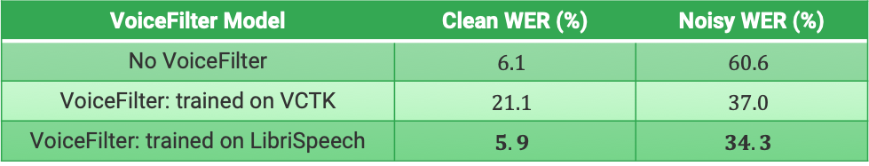
WER results: dataset matters
Compare different training data
Same topology, uni-LSTM
WER evaluated on VCTK
More training data help
LibriSpeech: 2338 training speakers
VCTK: 99 training speakers
VoiceFilter Model | Clean WER (%) | Noisy WER (%)
No VoiceFilter | $$6.1$$ | $$60.6$$
VoiceFilter: trained on VCTK | $$21.1$$ | $$37.0$$
VoiceFilter: trained on LibriSpeech | $$5.9$$ | $$34.3$$
Notes:
We also tried to fix the network topology, and use different training data. We found that even if we evaluate on VCTK, we have better performance when we train on LibriSpeech instead of VCTK. This is because VCTK has too few number of speakers, only 99, while LibriSpeech has more than two thousands. So the size of the dataset really matters a lot.

Slide 27
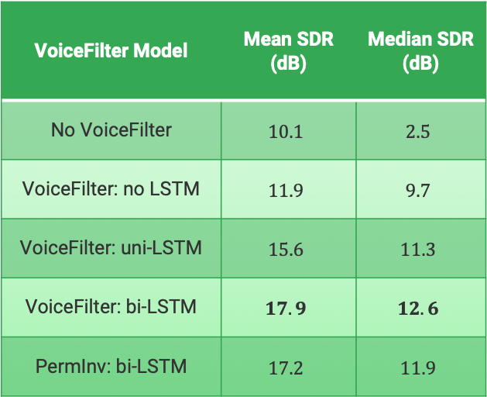
SDR Results
We report SDR on LibriSpeech
All models trained on LibriSpeech
SDR reported on training batches
Why Mean SDR so high?
Silent interference segments were extracted during random mixing
PermInv
Permutation invariant training as baseline
Take the output with higher SDR
VoiceFilter Model | Mean SDR (dB) | Median SDR (dB)
No VoiceFilter | $$10.1$$ | $$2.5$$
VoiceFilter: no LSTM | $$11.9$$ | $$9.7$$
VoiceFilter: uni-LSTM | $$15.6$$ | $$11.3$$
VoiceFilter: bi-LSTM | $$17.9$$ | $$12.6$$
PermInv: bi-LSTM | $$17.2$$ | $$11.9$$
Notes:
Here we also report the Source to Distortion Ratio on our LibriSpeech experiments. With the bi-direction LSTM, we can see the median SDR is much larger than without VoiceFilter. Specifically, the last row is the experiments of using the permutation invariant training. Our VoiceFilter has even better performance than this approach.
Some of you may question that, why the mean SDR is so high even without VoiceFilter. This is because when we add speech noise to the clean audio, the speech noise might be extracted from the silent part of the interference audio, ending up with some noisy audios are not noisy at all. But the clean and inference audios are actually of the same volume in our experiments.

Slide 28
Part 6:
Conclusions and Future Work
Notes:
Finally, conclusions and future work.

Slide 29
Conclusions
Our contributions in this paper:
Proposed a speaker-conditioned voice separation framework
Demonstrated:
Significant WER improvement for multi-speaker scenarios
Minimal degradation in single-speaker scenarios
Better SDR than permutation invariant training
Performance can potentially further improve if using more data
Notes:
The contributions of this paper include:
We proposed this speaker-conditioned voice separation framework, named VoiceFilter.
We demonstrated that our system has significant Word Error Rate improvements for multi-speaker scenarios, and minimal degradation in single-speaker scenarios.
It also has better Source to Distortion Ratio than permutation invariant training, and performance could be further improved by using more data.

Slide 30
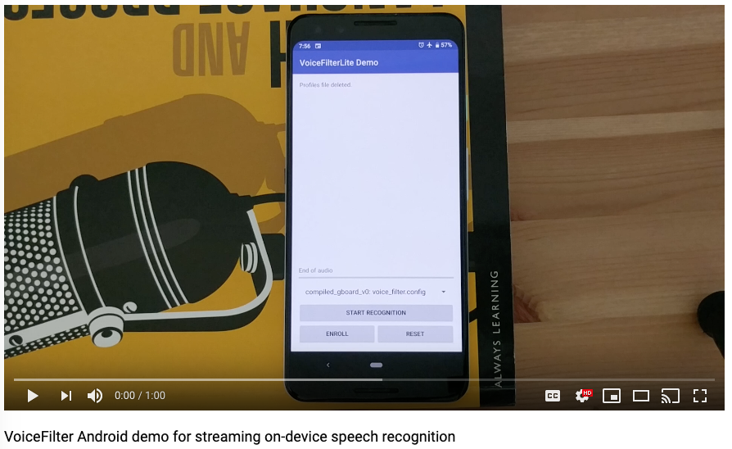
Work in Progress
Online inference with zero latency
Get rid of time-domain CNNs and bi-directional LSTMs
Reduce model size
Optimize network topology
Model quantization
Make it more useful
Joint voice separation and speech enhancement (denoising)
Better performance
Joint training with ASR
Notes:
Some of the future work directions.
For the long term, we want to build a model that is tiny, and performs online inference to make it more portable.
We want the model to do speech separation and denoising at the same time to make it more useful.
We also want to train the model jointly with ASR, which should give us even better performance.
Here is a video demo of our early prototype.

Slide 31
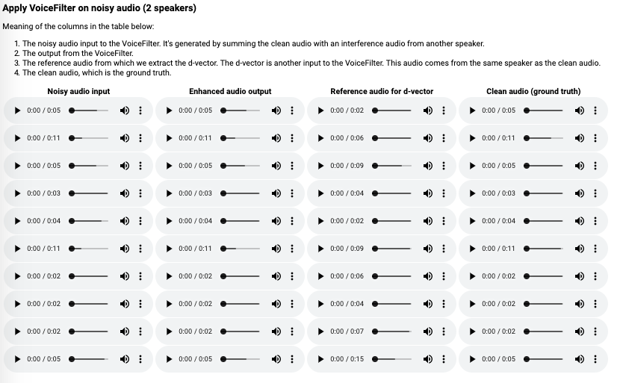
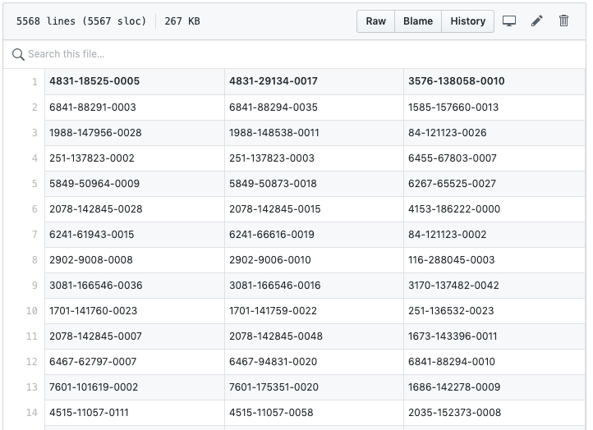
More Information
Check out https://google.github.io/speaker-id/publications/VoiceFilter/
Audio samples
Demo videos
Evaluation protocols (for comparison experiments)
Notes:
If you want to learn more about this work, or listen to more samples, you can check this website on GitHub.

Slide 32
Questions?
Notes:
Let me know if you have any questions.

Slide 33
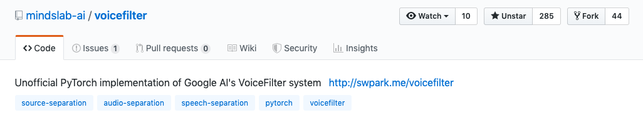
Acknowledgement
Mr. Seungwon Park from MINDs Lab open-sourced a third-party unofficial implementation
https://github.com/mindslab-ai/voicefilter

